Slide 1






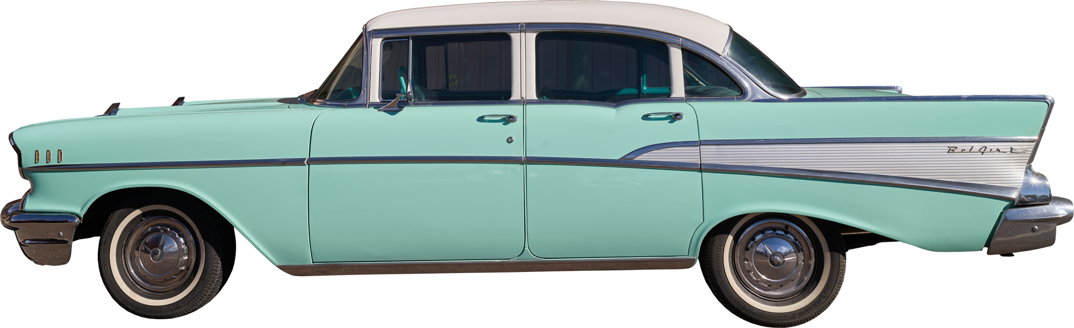
Car Price
Prediction
using Regression
Aya mohamed

Slide 2



Back to Agenda Page
Introduction
Objective:
Predict the selling price of cars based on various features such as year, fuel type, seller type, transmission, etc.
Use two regression models: Linear Regression and Lasso Regression to compare their performance.
Dataset:
Car_Name, Year, Selling_Price, Present_Price, Kms_Driven, Fuel_Type, Seller_Type, Transmission, Owner.

Slide 3
Data Loading and Exploration
Back to Agenda Page
Initial Exploration:
Shape of the dataset: 301 rows and 9 columns.
Dataset has no missing values.
Categorical Data Overview:
Fuel_Type: Petrol, Diesel, CNG.
Seller_Type: Dealer, Individual.
Transmission: Manual, Automatic.

Slide 4
Back to Agenda Page
Data Preprocessing
Data Encoding:
Convert categorical variables to numeric:
Fuel_Type: Petrol -> 0, Diesel -> 1, CNG -> 2.
Seller_Type: Dealer -> 0, Individual -> 1.
Transmission: Manual -> 0, Automatic -> 1.
Feature Selection:
Drop Car_Name (non-numeric, irrelevant for price prediction).
X (features) = All columns except Selling_Price.
Y (target) = Selling_Price.

Slide 5
Model 1: Linear Regression
Back to Agenda Page
Model Description:
Linear Regression models the relationship between the target variable and the input features.
Training
Split data into training and testing sets (90% train, 10% test).
Fit the model to the training data.
Evaluation
R-squared score .

Slide 6
Model 2: Lasso Regression
Back to Agenda Page
Model Description:
asso Regression is a linear model with L1 regularization, which helps reduce overfitting.
Training
Fit the Lasso model to the training data.
Evaluation
R-squared score (Training Data): [Error score from your code].
R-squared score (Testing Data): [Error score from your code].

Slide 7
Model Comparison
Back to Agenda Page
R-squared Score:
Linear Regression vs Lasso Regression on both training and test sets.
Key Insights:
Discuss which model performed better.
Highlight how Lasso's regularization might help avoid overfitting but could lead to slightly lower performance on the test set.

Slide 8
Conclusion
Back to Agenda Page
Summary
Developed and evaluated two regression models to predict car prices.
Linear Regression performed [better/similarly] compared to Lasso Regression.

